Slide 1

Machine Learning and Data Mining
Lecture 4.1: Naïve Bayes (cont.) and Multiclass Classification

Slide 3
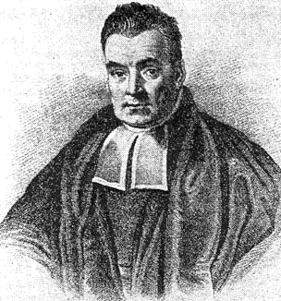
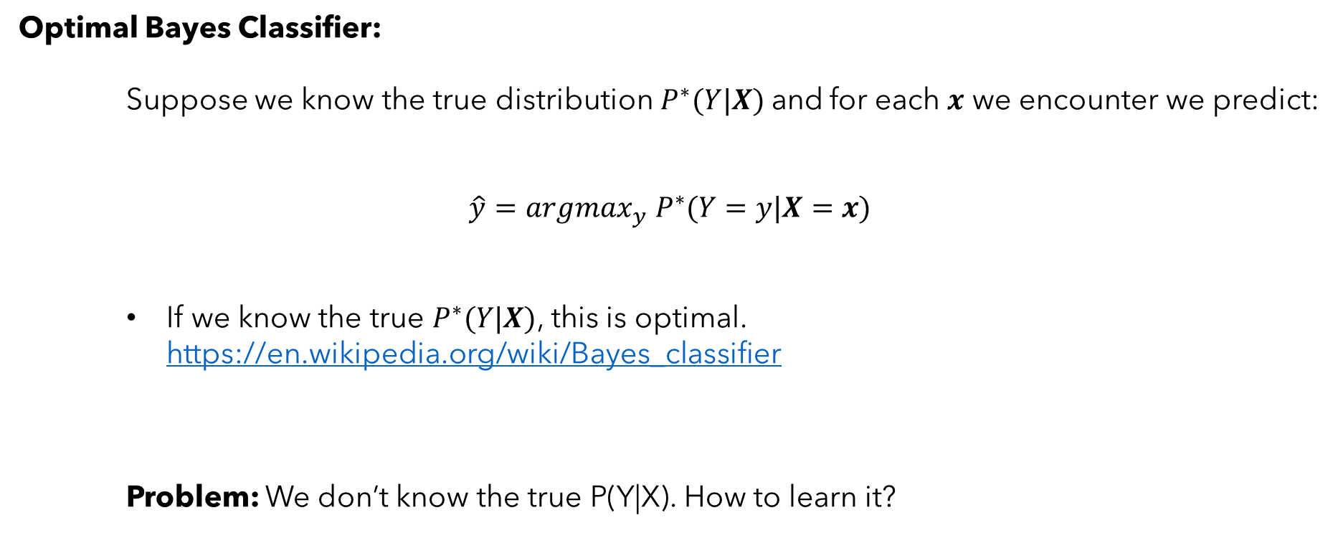
What is a Bayes Classifier?
Optimal Bayes Classifier:
Suppose we know the true distribution$P^{∗}(Y|X)$and for each $x$ we encounter we predict:
$$\hat{y}=argmax_{y} P^{∗}(Y=y|X=x)$$
If we know the true $P^{∗}(Y|X)$, this is optimal. https://en.wikipedia.org/wiki/Bayes_classifier
Problem: We don’t know the true P(Y|X). How to learn it?

Slide 4
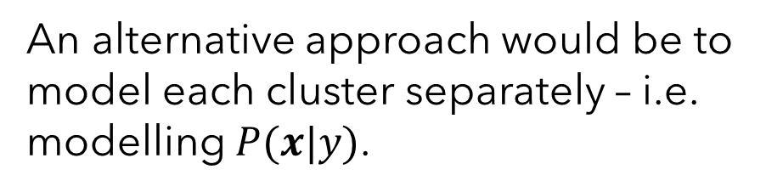
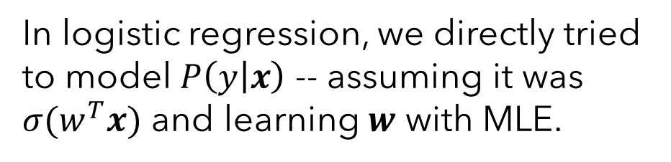
Generative vs. Discriminative Models
Problem: We don’t know the true $P(y|x).$How to learn it?
Consider the following binary classification problem (colors for labels):
In logistic regression, we directly tried to model $P\left(y | x\right)$ -- assuming it was $σ(w^{T}x)$ and learning $w$ with MLE.
An alternative approach would be to model each cluster separately – i.e. modelling $P(x|y)$.

Slide 5
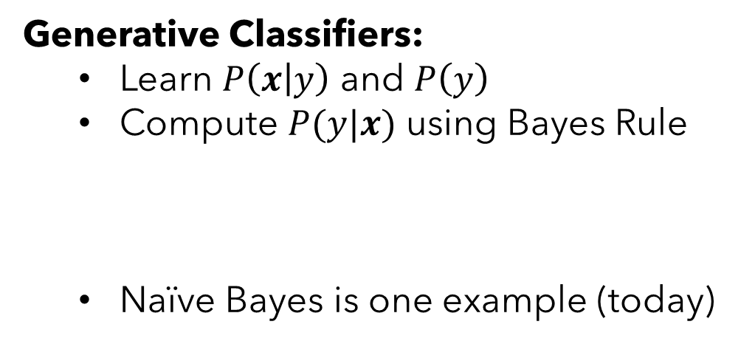
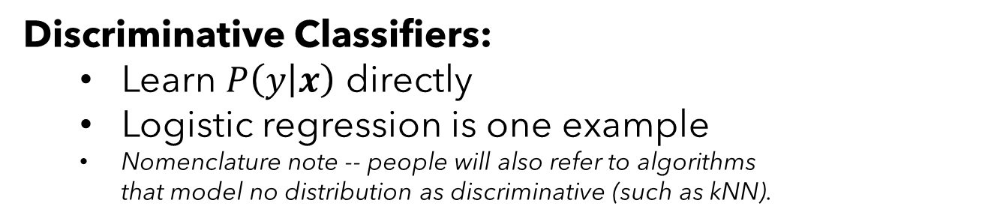

Generative vs. Discriminative Models
Discriminative Classifiers:
Learn $P\left(y | x\right)$ directly
Logistic regression is one example
Nomenclature note -- people will also refer to algorithms that model no distribution as discriminative (such as kNN).
Generative Classifiers:
Learn $P\left(x | y\right)$ and $P\left(y\right)$
Compute $P(y|x)$ using Bayes Rule
Naïve Bayes is one example (today)
$$P\left(y | x\right)=\frac{P\left(x | y\right)P\left(y\right)}{P(x)}=\frac{P\left(x | y\right)P\left(y\right)}{\sum_{y}{P\left(x | y\right)P\left(y\right)}}$$
Both classify according to argmax $P(y|x)$. Just learn and represent it differently.

Slide 6

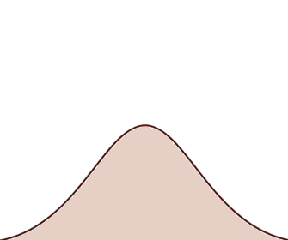
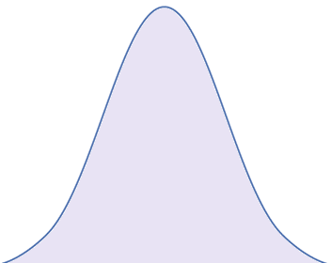

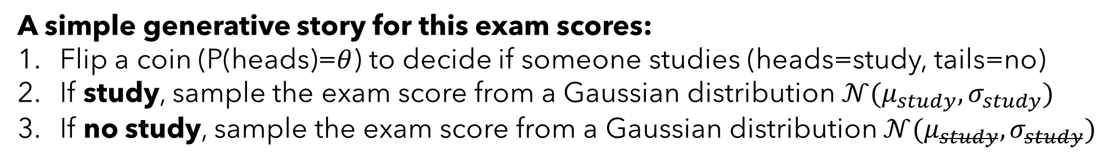



Generative Classifiers – Example 1: Studying Students
A simple generative story for this exam scores:
Flip a coin (P(heads)=$θ$) to decide if someone studies (heads=study, tails=no)
If study, sample the exam score from a Gaussian distribution $𝒩(μ_{study}, σ_{study})$
If no study, sample the exam score from a Gaussian distribution $𝒩(μ_{study}, σ_{study})$
$$𝒩(μ_{study}, σ_{study})$$
$$𝒩(μ_{study}, σ_{study})$$
P(study)=$1−θ$
P(study)=$θ$
Exam Score

Slide 7
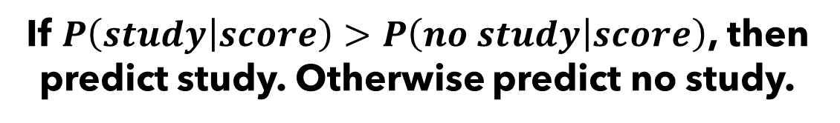
Generative Classifiers – Example 1: Studying Students
Given an observed exam score, how would this story help us predict whether the student studied? Bayes rule to the rescue again.
$$P\left(study | score\right)∝P\left(score | study\right)P(study)$$
$$=𝒩\left(score; μ_{study}, σ_{study}\right)θ$$
$$P\left(no study | score\right)∝P\left(score | no study\right)P(no study)$$
$$=𝒩\left(score; μ_{study}, σ_{study}\right)\left(1−θ\right)$$
If $P\left(study | score\right)>P\left(no study | score\right)$, then predict study. Otherwise predict no study.

Slide 8
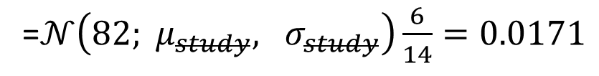
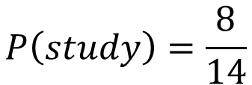
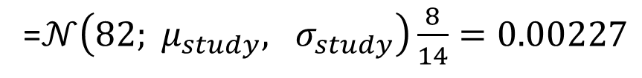
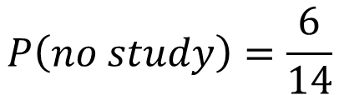
Generative Classifiers – Example 1: Studying Students
Study? | Score
Yes | 87
Yes | 89
Yes | 87
Yes | 88
Yes | 91
Yes | 97
Yes | 91
Yes | 93
No | 80
No | 77
No | 64
No | 75
No | 91
$$P\left(study\right)=\frac{8}{14}$$
$$P\left(no study\right)=\frac{6}{14}$$
$P\left(score|study\right)=$ $𝒩(score; μ_{study}=90.375, σ_{study}=3.19)$
$P\left(score|study\right)=$ $𝒩(score; μ_{study}=77.4, σ_{study}=8.68)$
See a new score of 82, did the student study?
$$P\left(study | 82\right)∝P\left(82|study\right)P(study)$$
=$𝒩\left(82; μ_{study}, σ_{study}\right)\frac{8}{14}=0.00227$
$$P\left(no study | 82\right)∝P\left(82|no study\right)P(no study)$$
=$𝒩\left(82; μ_{study}, σ_{study}\right)\frac{6}{14}=0.0171$

Slide 9
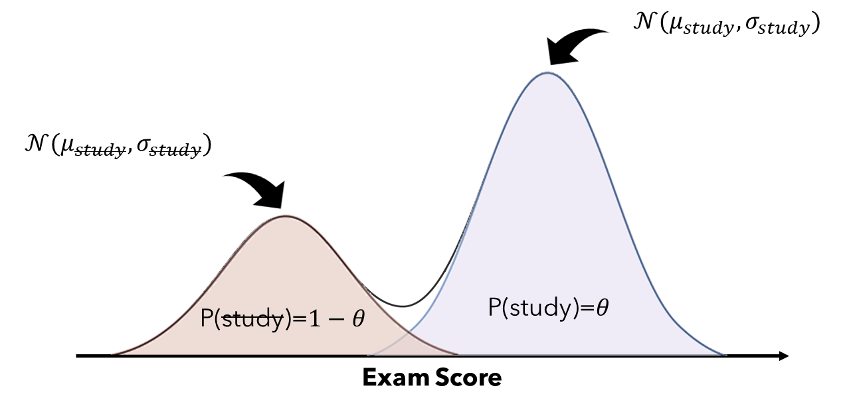
Generative Classifiers – Example 1: Studying Students
This example had binary labels (y=study / no study) and only a single continuous feature (x=exam score). But we can do similar things with many more features or classes.

Slide 10

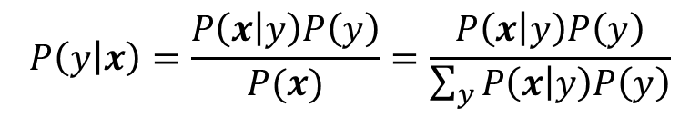
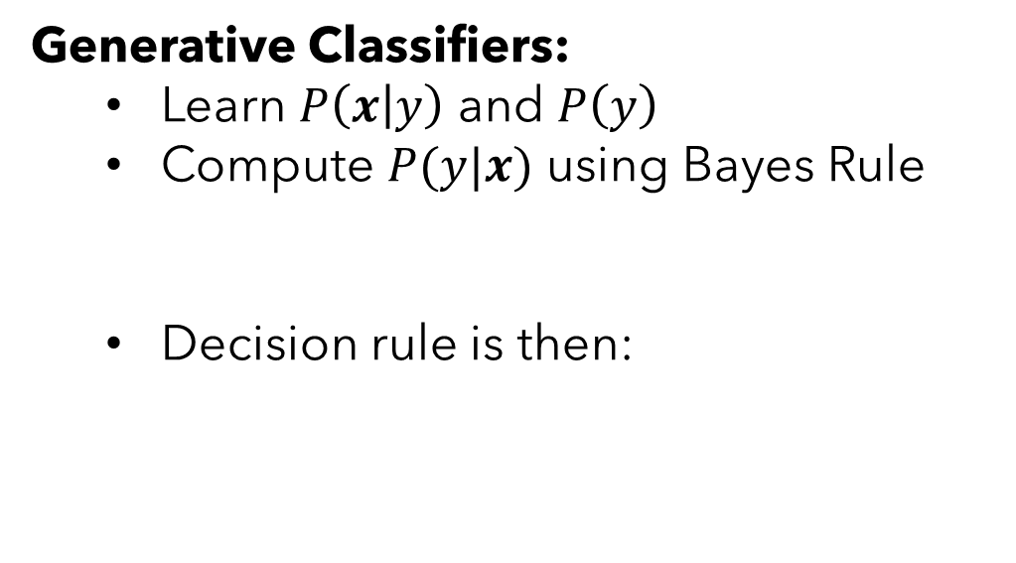

Generative Classifiers
Generative Classifiers:
Learn $P\left(x | y\right)$ and $P\left(y\right)$
Compute $P(y|x)$ using Bayes Rule
Decision rule is then:
$$P\left(y | x\right)=\frac{P\left(x | y\right)P\left(y\right)}{P(x)}=\frac{P\left(x | y\right)P\left(y\right)}{\sum_{y}{P\left(x | y\right)P\left(y\right)}}$$
$$\hat{y}=argmax_{c} P\left(x | c\right)P(c)$$
This conditional over x can be EXPENSIVE depending on dimensionality and model choice

Slide 11

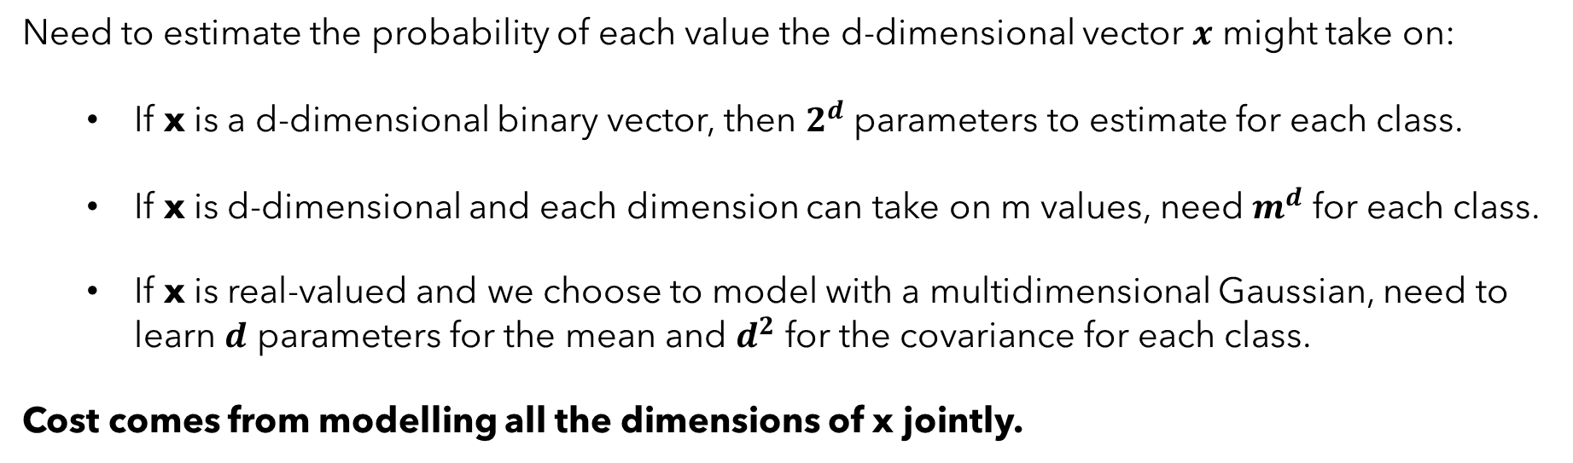
Generative Classifiers
$$\hat{y}=argmax_{c} P\left(x | c\right)P(c)$$
This conditional over x can be EXPENSIVE depending on dimensionality and model choice
Need to estimate the probability of each value the d-dimensional vector $x$ might take on:
If x is a d-dimensional binary vector, then $2^{d}$ parameters to estimate for each class.
If x is d-dimensional and each dimension can take on m values, need $m^{d}$ for each class.
If x is real-valued and we choose to model with a multidimensional Gaussian, need to learn $d$ parameters for the mean and $d^{2}$ for the covariance for each class.
Cost comes from modelling all the dimensions of x jointly.

Slide 12
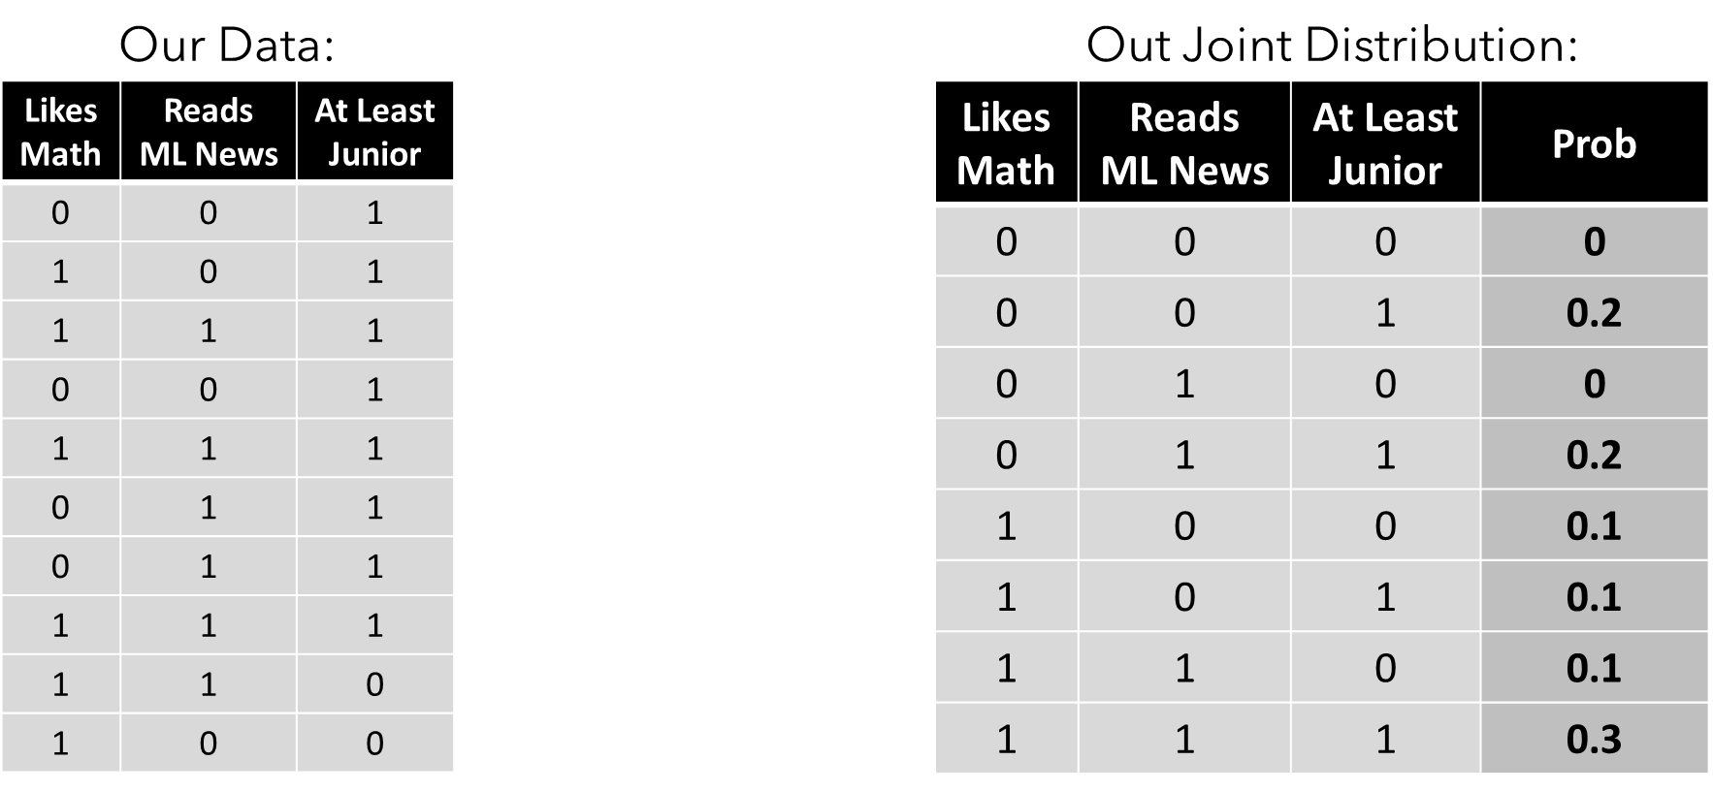
Generative Classifiers
$$\hat{y}=argmax_{c} P\left(x | c\right)P(c)$$
This conditional over x can be EXPENSIVE depending on dimensionality and model choice
Modelling all dimensions jointly can also lead to sparse data and zeros in our estimated distributions:

Slide 13

Naïve Bayes Model Idea
The Naïve Bayes Assumption:
Each feature is conditionally independent given the class label.
$$P\left(x | y\right)=\prod_{i=1}^{d}{P(x_{i}|y)}$$
This has significant impacts on the cost of parameter estimation!

Slide 14


Bayes Model (without naïve assumption)
$$P(x|y=yes)$$
$$P(x|y=no)$$
Our Data:
Color | Type | P(x|yes)
Red | Sport
Red | SUV
Red | Truck
Red | Sedan
Blue | Sport
Blue | SUV
Blue | Truck
Blue | Sedan
Silver | Sport
Silver | SUV
Silver | Truck
Silver | Sedan
Tan | Sport
Tan | SUV
Tan | Truck
Tan | Sedan
Color | Type | P(x|yes)
Red | Sport
Red | SUV
Red | Truck
Red | Sedan
Blue | Sport
Blue | SUV
Blue | Truck
Blue | Sedan
Silver | Sport
Silver | SUV
Silver | Truck
Silver | Sedan
Tan | Sport
Tan | SUV
Tan | Truck
Tan | Sedan
Color | Type | Stolen
Red | Sport | Yes
Red | SUV | Yes
Blue | Truck | Yes
Red | Sedan | Yes
Blue | Sedan | Yes
Tan | Truck | No
Silver | Truck | No
Tan | Sport | No
Tan | Truck | Yes
Tan | SUV | No

Slide 15
Bayes Model (without naïve assumption)
$$P(x|y=yes)$$
$$P(x|y=no)$$
Our Data:
Color | Type | P(x|yes)
Red | Sport | 1/7
Red | SUV | 1/7
Red | Truck | 0
Red | Sedan | 1/7
Blue | Sport | 0
Blue | SUV | 0
Blue | Truck | 1/7
Blue | Sedan | 1/7
Silver | Sport | 0
Silver | SUV | 0
Silver | Truck | 1/7
Silver | Sedan | 0
Tan | Sport | 0
Tan | SUV | 0
Tan | Truck | 1/7
Tan | Sedan | 0
Color | Type | P(x|yes)
Red | Sport
Red | SUV
Red | Truck
Red | Sedan
Blue | Sport
Blue | SUV
Blue | Truck
Blue | Sedan
Silver | Sport
Silver | SUV
Silver | Truck
Silver | Sedan
Tan | Sport
Tan | SUV
Tan | Truck
Tan | Sedan
Color | Type | Stolen
Red | Sport | Yes
Red | SUV | Yes
Blue | Truck | Yes
Red | Sedan | Yes
Blue | Sedan | Yes
Tan | Truck | No
Silver | Truck | No
Tan | Sport | No
Tan | Truck | Yes
Tan | SUV | No

Slide 16
Bayes Model (without naïve assumption)
$$P(x|y=yes)$$
$$P(x|y=no)$$
Our Data:
Color | Type | P(x|yes)
Red | Sport | 1/7
Red | SUV | 1/7
Red | Truck | 0
Red | Sedan | 1/7
Blue | Sport | 0
Blue | SUV | 0
Blue | Truck | 1/7
Blue | Sedan | 1/7
Silver | Sport | 0
Silver | SUV | 0
Silver | Truck | 1/7
Silver | Sedan | 0
Tan | Sport | 0
Tan | SUV | 0
Tan | Truck | 1/7
Tan | Sedan | 0
Color | Type | P(x|no)
Red | Sport | 0
Red | SUV | 0
Red | Truck | 0
Red | Sedan | 0
Blue | Sport | 0
Blue | SUV | 0
Blue | Truck | 0
Blue | Sedan | 0
Silver | Sport | 0
Silver | SUV | 0
Silver | Truck | 1/4
Silver | Sedan | 0
Tan | Sport | 1/4
Tan | SUV | 1/4
Tan | Truck | 1/4
Tan | Sedan | 0
Color | Type | Stolen
Red | Sport | Yes
Red | SUV | Yes
Blue | Truck | Yes
Red | Sedan | Yes
Blue | Sedan | Yes
Tan | Truck | No
Silver | Truck | No
Tan | Sport | No
Tan | Truck | Yes
Tan | SUV | No

Slide 17


Naïve Bayes
Our Data:
$$P(x|y=yes)$$
$$P(x|y=no)$$
Color | Type | Stolen
Red | Sport | Yes
Red | SUV | Yes
Blue | Truck | Yes
Red | Sedan | Yes
Blue | Sedan | Yes
Tan | Truck | No
Silver | Truck | No
Tan | Sport | No
Tan | Truck | Yes
Tan | SUV | No
Color | P(color|yes)
Red | 3/6
Blue | 2/6
Silver | 0
Tan | 1/6
Color | P(color|no)
Red | 0
Blue | 0
Silver | 1/4
Tan | 3/4
Type | P(type|yes)
Sport | 1/6
SUV | 1/6
Truck | 2/6
Sedan | 2/6
Type | P(type|no)
Sport | 1/4
SUV | 1/4
Truck | 2/4
Sedan | 0
Naïve Bayes results in fewer parameters and fewer zeros in the tables.

Slide 18


Zero-Probability Problem – Laplace Smoothing!
Probably a bad idea to encode “red cars are always stolen” into our models…
$$P(x|y=yes)$$
$$P(x|y=no)$$
Color | P(color|yes)
Red | 3/6
Blue | 2/6
Silver | 0
Tan | 1/6
Color | P(color|no)
Red | 0
Blue | 0
Silver | 1/4
Tan | 3/4
Type | P(type|yes)
Sport | 1/6
SUV | 1/6
Truck | 2/6
Sedan | 2/6
Type | P(type|no)
Sport | 1/4
SUV | 1/4
Truck | 2/4
Sedan | 0
And in general, saying something has “zero probability” is very strong statement.

Slide 19




Zero-Probability Problem – Laplace Smoothing!
Laplace smoothing adds a “prior” to our learned categorical or Bernoulli conditional. As we saw in MAP for Bernoulli-Beta, this amounts to adding fake counts. For example, Laplace smoothing with a value of 1 adds one fake count to each possibility.
$$P(x|y=yes)$$
$$P(x|y=yes)$$
$$P(x|y=no)$$
$$P(x|y=no)$$
Color | P(color|yes)
Red | 3/6
Blue | 2/6
Silver | 0
Tan | 1/6
Color | P(color|yes)
Red | (3+1)/(6+4)
Blue | (2+1)/(6+4)
Silver | (0+1)/(6+4)
Tan | (1+1)/(6+4)
Color | P(color|no)
Red | 0
Blue | 0
Silver | 1/4
Tan | 3/4
Color | P(color|no)
Red | (0+1)/(4+4)
Blue | (0+1)/(4+4)
Silver | (1+1)/(4+4)
Tan | (3+1)/(4+4)
Type | P(type|yes)
Sport | 1/6
SUV | 1/6
Truck | 2/6
Sedan | 2/6
Type | P(type|yes)
Sport | (1+1)/(6+4)
SUV | (1+1)/(6+4)
Truck | (2+1)/(6+4)
Sedan | (2+1)/(6+4)
Type | P(type|no)
Sport | 1/4
SUV | 1/4
Truck | 2/4
Sedan | 0
Type | P(type|no)
Sport | (1+1)/(4+4)
SUV | (1+1)/(4+4)
Truck | (2+1)/(4+4)
Sedan | (0+1)/(4+4)

Slide 20
Zero-Probability Problem – Laplace Smoothing!
Laplace smoothing adds a “prior” to our learned categorical or Bernoulli conditional. As we saw in MAP for Bernoulli-Beta, this amounts to adding fake counts. For example, Laplace smoothing with a value of ⍺ adds ⍺ fake counts to each possibility. (⍺ need not be an integer)
$$P(x|y=yes)$$
$$P(x|y=yes)$$
$$P(x|y=no)$$
$$P(x|y=no)$$
Color | P(color|yes)
Red | 3/6
Blue | 2/6
Silver | 0
Tan | 1/6
Color | P(color|yes)
Red | (3+⍺)/(6+4⍺)
Blue | (2+⍺)/(6+4⍺)
Silver | (0+⍺)/(6+4⍺)
Tan | (1+⍺)/(6+4⍺)
Color | P(color|no)
Red | 0
Blue | 0
Silver | 1/4
Tan | 3/4
Color | P(color|no)
Red | (0+⍺)/(4+4⍺)
Blue | (0+⍺)/(4+4⍺)
Silver | (1+⍺)/(4+4⍺)
Tan | (3+⍺)/(4+4⍺)
Type | P(type|yes)
Sport | 1/6
SUV | 1/6
Truck | 2/6
Sedan | 2/6
Type | P(type|yes)
Sport | (1+⍺)/(6+4⍺)
SUV | (1+⍺)/(6+4⍺)
Truck | (2+⍺)/(6+4⍺)
Sedan | (2+⍺)/(6+4⍺)
Type | P(type|no)
Sport | 1/4
SUV | 1/4
Truck | 2/4
Sedan | 0
Type | P(type|no)
Sport | (1+⍺)/(4+4⍺)
SUV | (1+⍺)/(4+4⍺)
Truck | (2+⍺)/(4+4⍺)
Sedan | (0+⍺)/(4+4⍺)

Slide 21
If in the previous example, thieves were only stealing “red sportscars”, why would a Naïve Bayes model be a poor choice?

Slide 22
You are hired to predict whether a machine in a factory needs maintenance using Naïve Bayes. Each machine is represented by:
The average temperature of the machine in the last hour (continuous)
The number of outputs with defects in the last hour (non-negative integer)
Whether the machine has undergone maintenance in the last 6 months (binary)
What are class labels here? What conditionals need to be learned?
How would you choose to model these conditionals? (i.e., what distributions would you assume for each feature?)

Slide 23
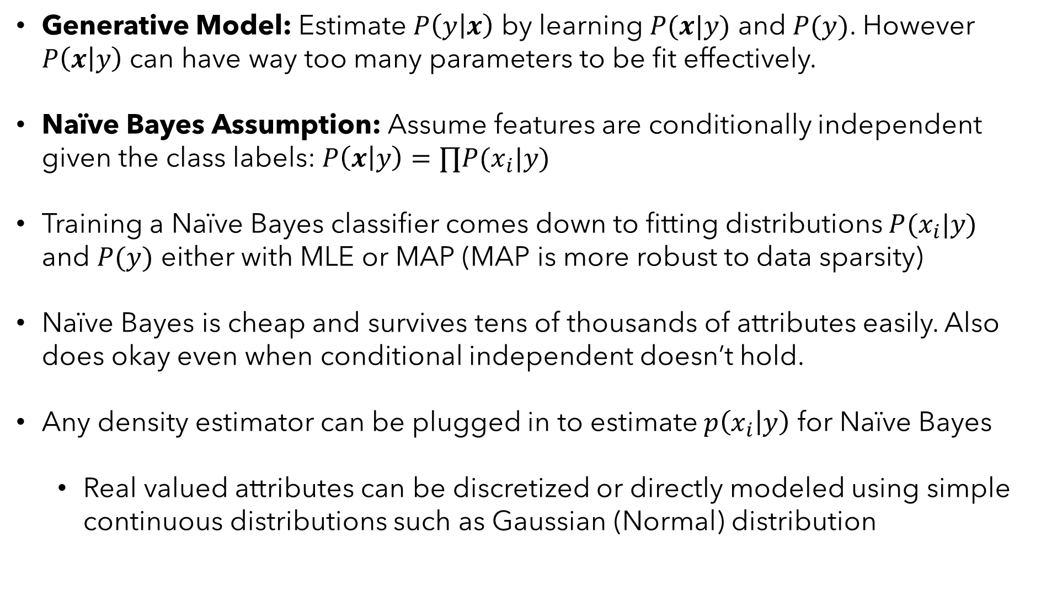
Summary of Naïve Bayes Classifier
Generative Model: Estimate $P\left(y | x\right)$ by learning $P(x|y)$ and $P(y)$. However $P\left(x | y\right)$ can have way too many parameters to be fit effectively.
Naïve Bayes Assumption: Assume features are conditionally independent given the class labels: $P\left(x | y\right)=∏P(x_{i}|y)$
Training a Naïve Bayes classifier comes down to fitting distributions $P(x_{i}|y)$ and $P(y)$ either with MLE or MAP (MAP is more robust to data sparsity)
Naïve Bayes is cheap and survives tens of thousands of attributes easily. Also does okay even when conditional independent doesn’t hold.
Any density estimator can be plugged in to estimate $p\left(x_{i} | y\right)$ for Naïve Bayes
Real valued attributes can be discretized or directly modeled using simple continuous distributions such as Gaussian (Normal) distribution

Slide 24
Be able to answer:
What is multi-class classification?
How can we do multi-class classification?
How do 1-vs-all / all-vs-all / tree- classifiers work?
How does multiclass logistic regression work?
What is the softmax function?
How to evaluate multi-class classifiers?
What is a multiclass confusion matrix?
How can recall and precision adapt to multiclass?

Slide 25





Multiclass Classification
Multiclass Classification describes classification algorithms capable of predicting between more than two possible output labels.
Example below would have 3 class – dog, cat, and fox.
$$x_{1}$$
$$x_{2}$$

Slide 26
Multiclass Classification
Some of the algorithm’s we’ve already covered already allow for this sort of problem:
1
k Nearest Neighbors basic decision rule:
Find the labels of closest k points
Label the current point as the majority
Doesn’t matter if there are 2 or 2000 classes, nothing changes in the algorithm!
$$x_{1}$$
3
2
$$x_{2}$$

Slide 27





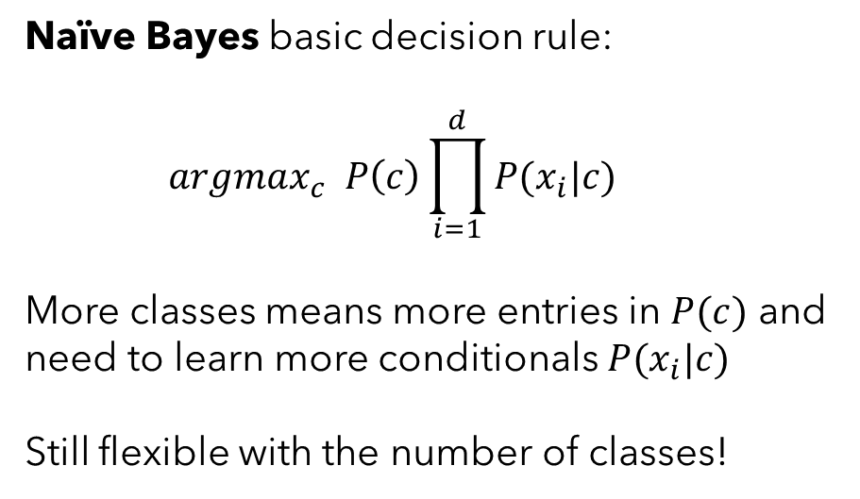

Multiclass Classification
Some of the algorithm’s we’ve already covered already allow for this sort of problem:
$$P(x_{1}|c=fox)$$
Naïve Bayes basic decision rule:
$$argmax_{c} P\left(c\right)\prod_{i=1}^{d}{P(x_{i}|c)}$$
More classes means more entries in $P(c)$ and need to learn more conditionals $P(x_{i}|c)$
Still flexible with the number of classes!
$$P(x_{2}|c=fox)$$
$$P(x_{1}|c=cat)$$
$$P(x_{2}|c=cat)$$
$$x_{1}$$
$$P(x_{1}|c=dog)$$
$$P(x_{2}|c=dog)$$
$$x_{2}$$

Slide 28
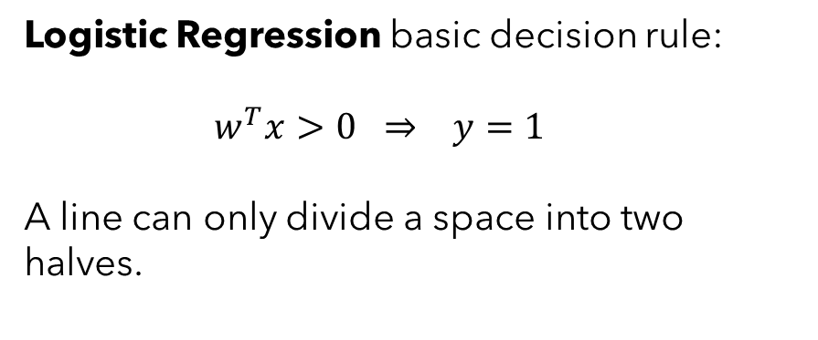
Multiclass Classification
Others don’t allow for this sort of problem by default:
Logistic Regression basic decision rule:
$$w^{T}x>0 ⇒ y=1$$
A line can only divide a space into two halves.
$$x_{1}$$
$$x_{2}$$

Slide 29
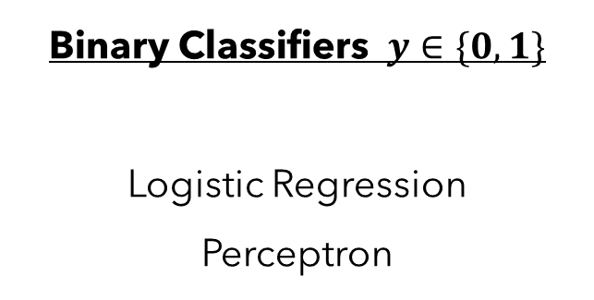
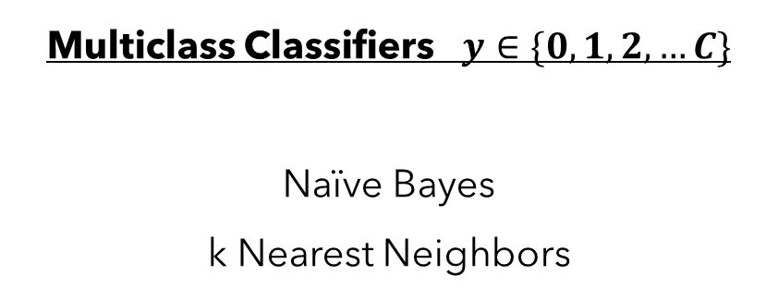
Multiclass Classification
Many of the classifiers we’ve discussed so far in class have been binary classifiers – i.e., algorithms that can predict whether an input is one of two possible classes.
However; some could handle multiple possible classes and are considered multiclass classifiers.
Binary Classifiers $y∈\{0,1\}$
Logistic Regression
Perceptron
Multiclass Classifiers $y∈\{0,1,2,…C\}$
Naïve Bayes
k Nearest Neighbors
Suppose I want to use Logistic Regression for a multiclass setting, how could I do that?

Slide 30






One-VS-All Multiclass Classifier
Train Three One-Vs-All Classifiers
Consider the following multiclass classification problem. How can we use binary classifiers to figure out if a new point is a fox, dog, or cat?
Cat-VS-All
$$x_{1}$$
$$x_{2}$$
Fox-VS-All
$$x_{1}$$
$$x_{1}$$
$$x_{2}$$
$$x_{2}$$
Dog-VS-All
$$x_{1}$$
$$x_{2}$$

Slide 31


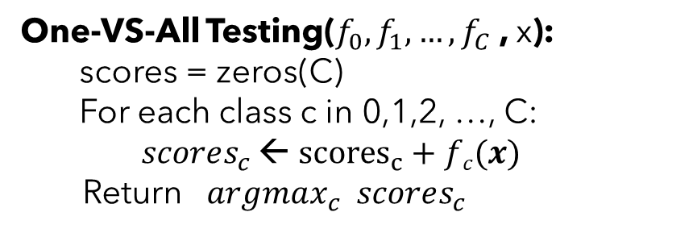
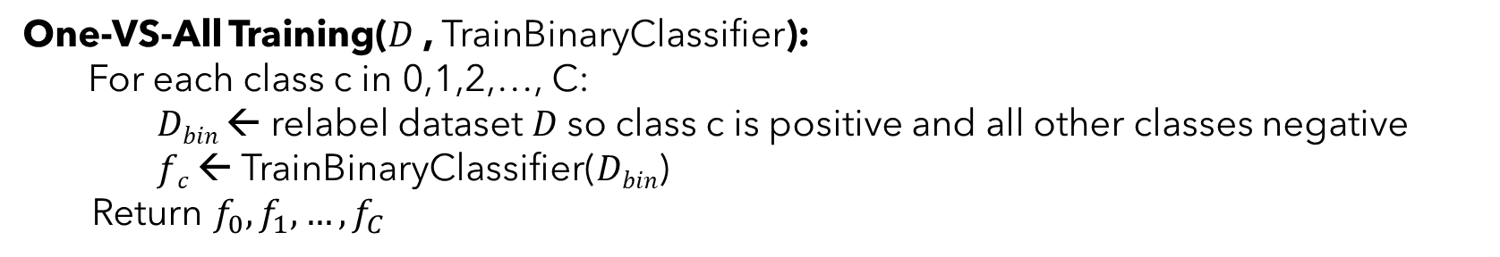
One-VS-All Multiclass Classifier
One-VS-All Training($D$, TrainBinaryClassifier):
For each class c in 0,1,2,…, C:
$Dbin$ ← relabel dataset $D$so class c is positive and all other classes negative
$fc$ ← TrainBinaryClassifier($Dbin$)
Return $f_{0}, f_{1}, …, f_{C}$
One-VS-All Testing($f_{0}, f_{1}, …, f_{C}$, x):
scores = zeros(C) For each class c in 0,1,2, …, C:
$scores_{c}$ ← ${scores}_{c}+fc(x)$
Return $argmax_{c} scores_{c}$
$$x_{1}$$
$$x_{2}$$

Slide 32

One-VS-All Multiclass Classifier
Problem: What happens in these areas?
Case 1: If the binary classifiers output comparable continuous scores (e.g., like a probability in logistic regression), can just take the argmax.
A
B
D
Case 2: If the binary classifiers just make 0/1 decisions (SVM / Perceptron), will need to choose randomly in those areas among relevant classes.
Cat/Fox in A, Fox/Cat in B, Dog/Cat in C, Cat/Fox/Dog in D
C
Error bound in case 2: Suppose the average error is $ε$, then the error rate of the One-VS-All classifier for multiclass classification is at most $\left(K−1\right)ε$ [Proof in this week’s reading]

Slide 33
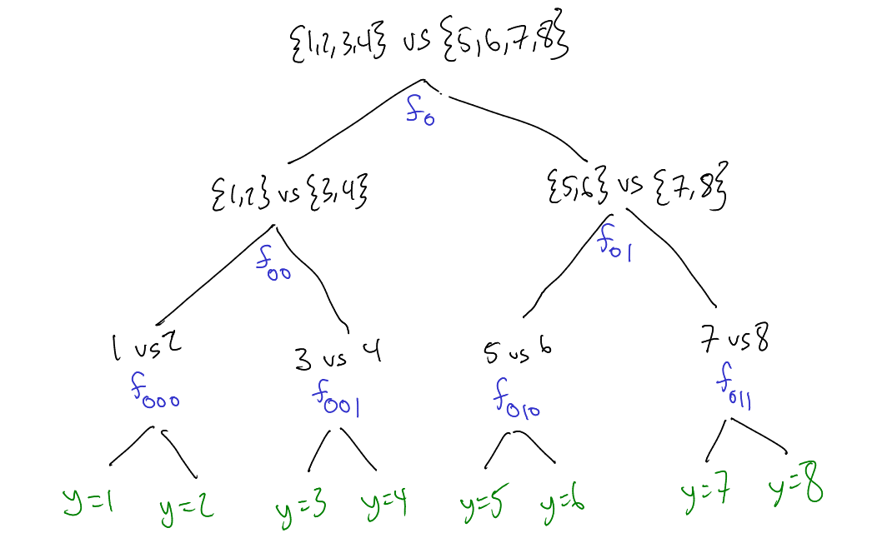

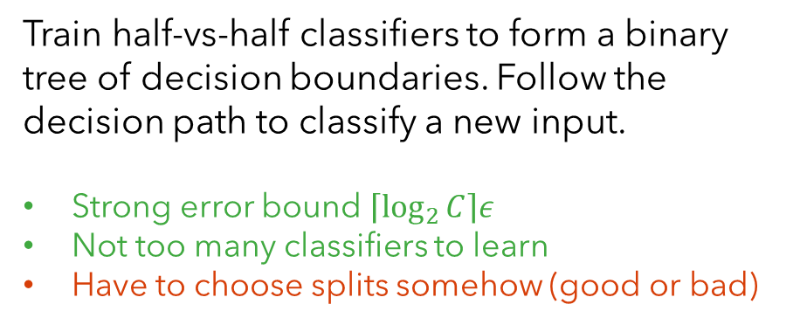
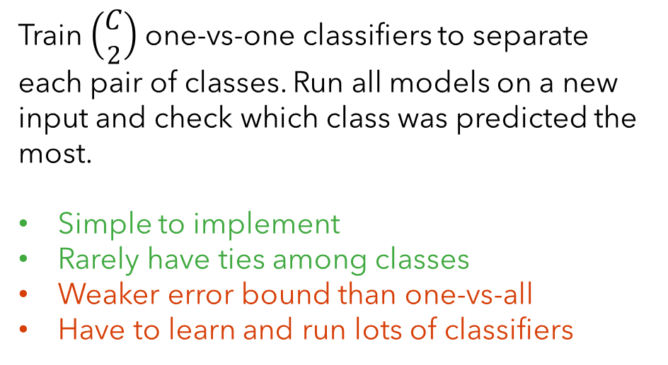

Other Options for Doing Multiclass with Binary Classifiers
Tree Classifier
All-VS-All Classifier
Train $\left(\begin{aligned}C \\ 2\end{aligned}\right)$ one-vs-one classifiers to separate each pair of classes. Run all models on a new input and check which class was predicted the most.
Simple to implement
Rarely have ties among classes
Weaker error bound than one-vs-all
Have to learn and run lots of classifiers
Train half-vs-half classifiers to form a binary tree of decision boundaries. Follow the decision path to classify a new input.
Strong error bound $\left\lceil \log_{2}{C}\right\rceil ε$
Not too many classifiers to learn
Have to choose splits somehow (good or bad)
$$x_{1}$$
$$x_{2}$$

Slide 34
Multiclass Classification
The methods we’ve just discussed are general ways to turn any binary classification method into a multiclass classification approach. However, they are a bit inelegant and expensive.
Would prefer to simply modify our classifiers to be multiclass to start with!
Support Vector Machines → Structured Support Vector Machines. (See SVMs soon!) Generalizes the notion of a margin to multiclass setting – adds some additional constraints. (Has some other significant new abilities for arbitrarily complex predictions beyond classes). See original 2001 paper.
Perceptron → Multiclass Perceptron.
Considers classification over an augmented feature $φ(x_{i}, y)$ that encodes both a datapoint and potential label – lets the perceptron learn a linear “compatibility” function between x and y. 17.1 in the textbook.
Logistic Regression → Multiclass Logistic Regression.
Today in class! Yay!

Slide 35
Be able to answer:
What is multi-class classification?
How can we do multi-class classification?
How do 1-vs-all / all-vs-all / tree- classifiers work?
How does multiclass logistic regression work?
What is the softmax function?
How to evaluate multi-class classifiers?
What is a multiclass confusion matrix?
How can recall and precision adapt to multiclass?

Slide 36
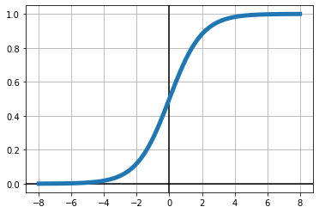
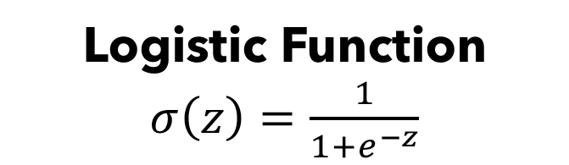

Logistic Function
Introducing the logistic function:
May also see it referred to as a sigmoid function or “logit” function
Logistic Function $σ\left(z\right)=\frac{1}{1+e^{−z}}$
Maps $(−∞, ∞)$ to $(0,1)$

Slide 37

Logistic Regression
Logistic Regression Model Assumption:
$$P\left(y_{i}=1 | x_{i};w\right)=σ\left(w^{T}x_{i}\right)=\frac{1}{1+e^{−w^{T}x_{i}}}$$
$$P\left(y_{i}=0 | x_{i};w\right)=1−σ\left(w^{T}x_{i}\right)=\frac{e^{−w^{T}x_{i}}}{1+e^{−w^{T}x_{i}}}$$

Slide 38
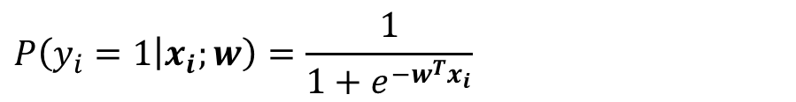
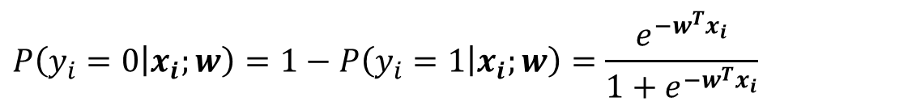
Recall Logistic Regression for Binary Classification
Model Assumption:
$$P\left(y_{i}=1 | x_{i};w\right)=\frac{1}{1+e^{−w^{T}x_{i}}}$$
$$P\left(y_{i}=0 | x_{i};w\right)=1−P\left(y_{i}=1 | x_{i};w\right)=\frac{e^{−w^{T}x_{i}}}{1+e^{−w^{T}x_{i}}}$$
Negative Log-Likelihood under a Bernoulli Model:
$$−logP\left(D∣w\right)=−\sum_{i=1}^{N}{y_{i}\log{σ\left(w^{T}x_{i}\right)}+{(1−y}_{i})\log\left(1−σ\left(w^{T}x_{i}\right)\right)}$$
Optimized parameter via gradient descent.
$$∇−logP\left(D∣w\right)=\sum_{i=1}^{N}{∇l_{i}}=\sum_{i=1}^{N}{\left(σ\left(w^{T}x_{i}\right)−y_{i}\right)x_{i}}$$

Slide 39
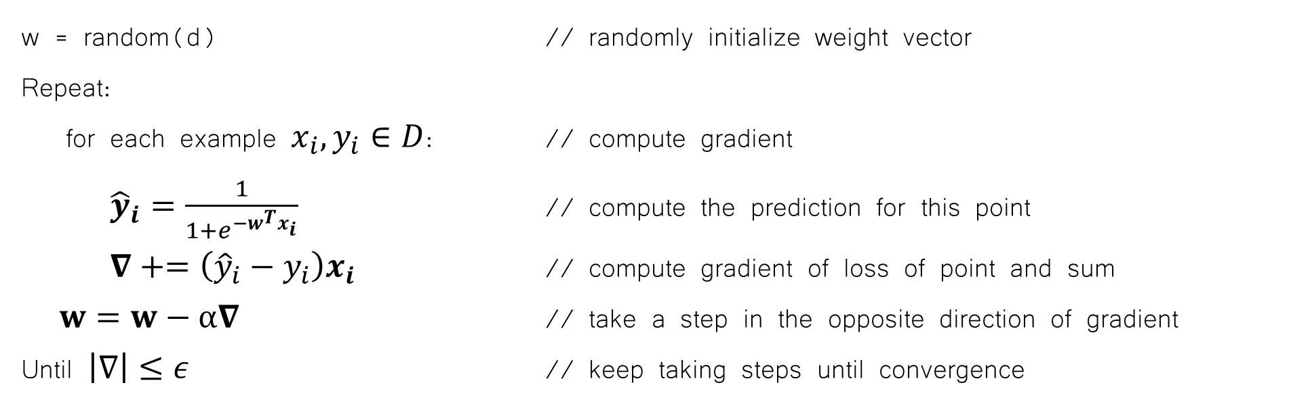
MLE for Logistic Regression
So we have an expression for the gradient but can’t find the optimal analytically…
$$∇−logP\left(D∣w\right)=\sum_{i=1}^{N}{∇l_{i}}=\sum_{i=1}^{N}{\left(σ\left(w^{T}x_{i}\right)−y_{i}\right)x_{i}}$$
Gradient Descent Algorithm for Logistic Regression
w = random(d) // randomly initialize weight vector
Repeat:
for each example $x_{i}, y_{i}∈D$: // compute gradient
${\hat{y}}_{i}=\frac{1}{1+e^{−w^{T}x_{i}}}$ // compute the prediction for this point
$∇+=\left({\hat{y}}_{i}−y_{i}\right)x_{i}$ // compute gradient of loss of point and sum
$w=w−α∇$ // take a step in the opposite direction of gradient
Until $\left|∇\right|≤ε$ // keep taking steps until convergence

Slide 40
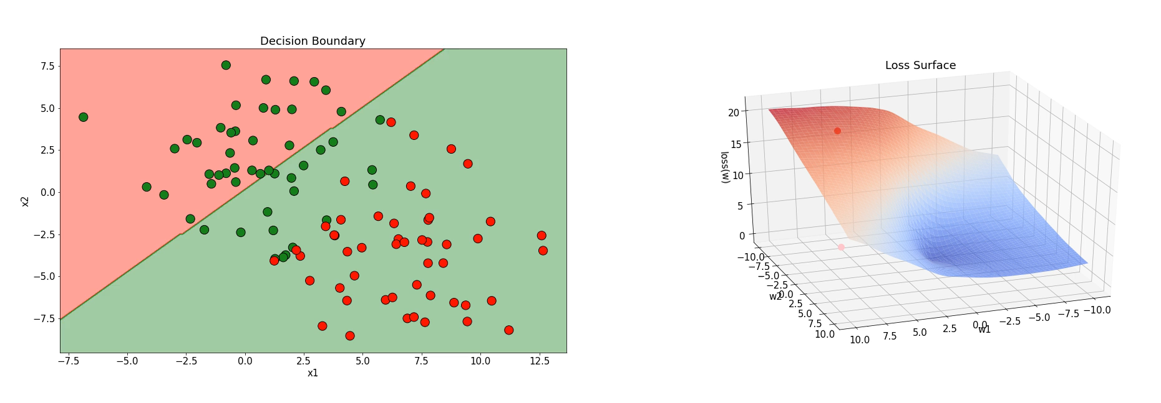
An example of Logistic Regression with Gradient Descent

Slide 41
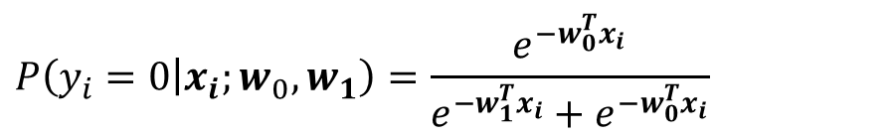
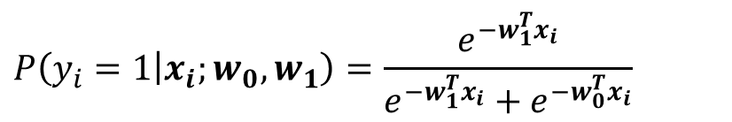
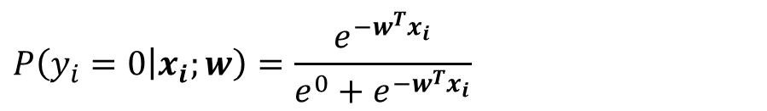
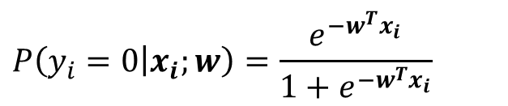
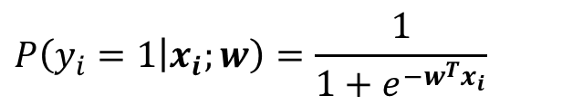
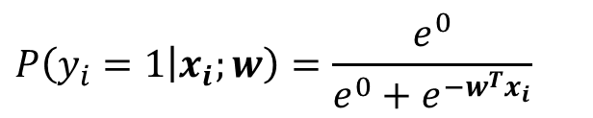
Recall Logistic Regression for Binary Classification
Model Assumption:
$$P\left(y_{i}=1 | x_{i};w\right)=\frac{1}{1+e^{−w^{T}x_{i}}}$$
$$P\left(y_{i}=0 | x_{i};w\right)=\frac{e^{−w^{T}x_{i}}}{1+e^{−w^{T}x_{i}}}$$
I want to start playing with this a little. Let’s start by replacing 1 with $e^{0}$
$$P\left(y_{i}=1 | x_{i};w\right)=\frac{e^{0}}{e^{0}+e^{−w^{T}x_{i}}}$$
$$P\left(y_{i}=0 | x_{i};w\right)=\frac{e^{−w^{T}x_{i}}}{e^{0}+e^{−w^{T}x_{i}}}$$
Let $w_{1}=\vec{0}$ and $w_{0}=w$, could write this as:
$$P\left(y_{i}=1 | x_{i};w_{0}, w_{1}\right)=\frac{e^{−w_{1}^{T}x_{i}}}{e^{−w_{1}^{T}x_{i}}+e^{−w_{0}^{T}x_{i}}}$$
$$P\left(y_{i}=0 | x_{i};w_{0},w_{1}\right)=\frac{e^{−w_{0}^{T}x_{i}}}{e^{−w_{1}^{T}x_{i}}+e^{−w_{0}^{T}x_{i}}}$$

Slide 42
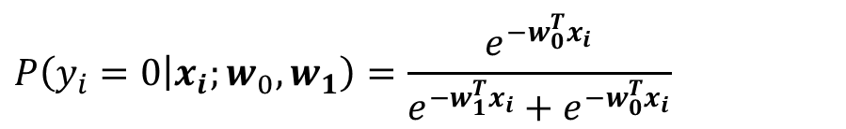
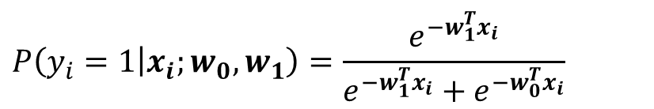
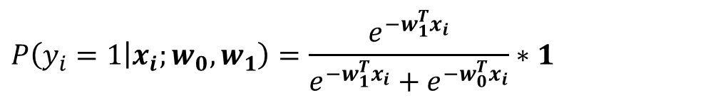
Recall Logistic Regression for Binary Classification
Tweaked Model Assumption:
Let $w_{1}=\vec{0}$ and $w_{0}=w$, could write this as:
$$P\left(y_{i}=1 | x_{i};w_{0}, w_{1}\right)=\frac{e^{−w_{1}^{T}x_{i}}}{e^{−w_{1}^{T}x_{i}}+e^{−w_{0}^{T}x_{i}}}$$
$$P\left(y_{i}=0 | x_{i};w_{0},w_{1}\right)=\frac{e^{−w_{0}^{T}x_{i}}}{e^{−w_{1}^{T}x_{i}}+e^{−w_{0}^{T}x_{i}}}$$
If we relax this restriction and let $w_{1}$ be anything, does it change the problem? Let’s see.
Ask if $P\left(y_{i}=1 | x_{i};w_{0},w_{1}\right) = P\left(y_{i}=1 | x_{i};w\right)$ for some $w′$
$$P\left(y_{i}=1 | x_{i};w_{0}, w_{1}\right)=\frac{e^{−w_{1}^{T}x_{i}}}{e^{−w_{1}^{T}x_{i}}+e^{−w_{0}^{T}x_{i}}}∗1$$
$$=\frac{e^{−w_{1}^{T}x_{i}}}{e^{−w_{1}^{T}x_{i}}+e^{−w_{0}^{T}x_{i}}}∗\frac{e^{w_{1}^{T}x_{i}}}{e^{w_{1}^{T}x_{i}}} = \frac{e^{−w_{1}^{T}x_{i}+w_{1}^{T}x_{i}}}{e^{−w_{1}^{T}x_{i}+w_{1}^{T}x_{i}}+e^{−w_{0}^{T}x_{i}+w_{1}^{T}x_{i}}}= \frac{e^{0}}{e^{0}+e^{−w_{0}^{T}x_{i}+w_{1}^{T}x_{i}}}$$
$$=\frac{1}{1+e^{−{\left(w_{0}−w_{1}\right)}^{T}x_{i}}}=P\left(y_{i}=1 | x_{i};w′\right)$$
Nope. Same model, just more parameters.

Slide 43

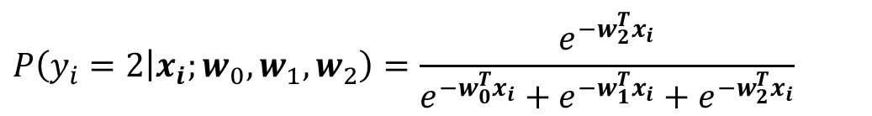

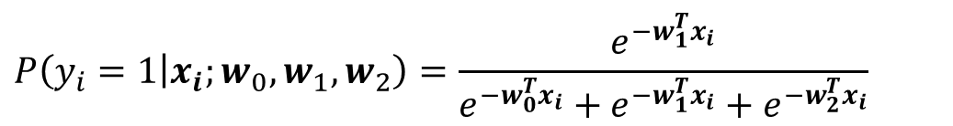
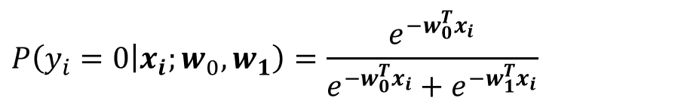
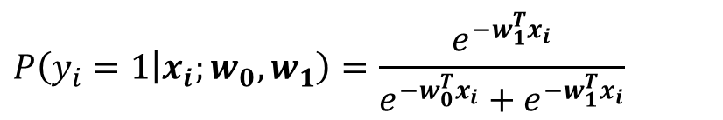
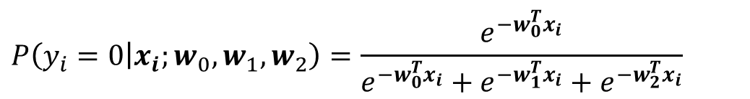
Moving To Multiclass Logistic Regression
Binary Model Assumption:
$$P\left(y_{i}=0 | x_{i};w_{0},w_{1}\right)=\frac{e^{−w_{0}^{T}x_{i}}}{e^{−w_{0}^{T}x_{i}}+e^{−w_{1}^{T}x_{i}}}$$
$$P\left(y_{i}=1 | x_{i};w_{0}, w_{1}\right)=\frac{e^{−w_{1}^{T}x_{i}}}{e^{−w_{0}^{T}x_{i}}+e^{−w_{1}^{T}x_{i}}}$$
Can we generalize this form to three classes?
$$P\left(y_{i}=0 | x_{i};w_{0},w_{1}, w_{2}\right)=\frac{e^{−w_{0}^{T}x_{i}}}{e^{−w_{0}^{T}x_{i}}+e^{−w_{1}^{T}x_{i}}+e^{−w_{2}^{T}x_{i}}}$$
Sanity checks:
$$P\left(y_{i}=1 | x_{i};w_{0},w_{1}, w_{2}\right)=\frac{e^{−w_{1}^{T}x_{i}}}{e^{−w_{0}^{T}x_{i}}+e^{−w_{1}^{T}x_{i}}+e^{−w_{2}^{T}x_{i}}}$$
$$P\left(y_{i}=c | x_{i};w_{0},w_{1}, w_{2}\right)≥0$$
$$∑P\left(y_{i}=c | x_{i};w_{0},w_{1}, w_{2}\right)=1$$
$$P\left(y_{i}=2 | x_{i};w_{0},w_{1}, w_{2}\right)=\frac{e^{−w_{2}^{T}x_{i}}}{e^{−w_{0}^{T}x_{i}}+e^{−w_{1}^{T}x_{i}}+e^{−w_{2}^{T}x_{i}}}$$

Slide 44
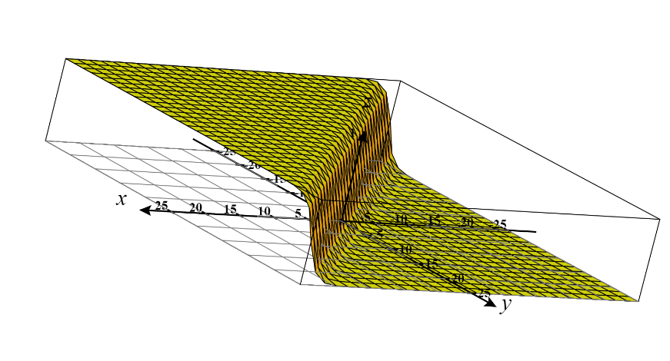


A Note About The Softmax Function
This functional form has a name – the softmax function. It turns a real-valued vector $ℝ^{d}$ to a categoric distribution -- i.e. each element in $\left(0,1\right)$ and it sums to 1.
$$\frac{e^{a}}{e^{a}+e^{b}}$$
$$Softmax\left(\left[\begin{aligned}z_{1} \\ z_{2} \\ ⋮ \\ z_{d}\end{aligned}\right]\right)=\left[\begin{aligned}e^{z_{1}} \\ e^{z_{2}} \\ ⋮ \\ e^{z_{d}}\end{aligned}\right]\frac{1}{\sum_{i=1}^{d}{e^{z_{i}}}}$$
“max” – amplifies probability of largest $x_{i}$
“soft” – differentiable and still assigns non-zero probability to other entries

Slide 45



Multiclass Logistic Regression
Dataset: Given a dataset $D={\left\{(x_{i},y_{i})\right\}}_{i=1}^{N}$ where $y_{i}∈\{0,1,2,…,C\}$
$$y_{i}∼Categorical\left(θ_{c}=\frac{e^{−w_{c}^{T}x_{i}}}{\sum_{j}{e^{−w_{j}^{T}x_{i}}}}\right)$$
Model assumptions:
$$⇒P\left(y_{i} | x_{i},w_{0}, …w_{c}\right)=\prod_{c=1}^{C}{{θ_{c}}^{𝕀[y_{i}==c]}=θ_{y_{i}}}$$
Write the negative log-likelihood of the training data as a function of parameters:
$$−logP\left(D∣w_{0}, …w_{c}\right)=−\sum_{i=1}^{N}{logP\left(y_{i} | x_{i},w_{0}, …w_{c}\right)}=−\sum_{i=1}^{N}{\log{\frac{e^{−w_{y_{i}}^{T}x_{i}}}{\sum_{j}{e^{−w_{j}^{T}x_{i}}}}}}$$

Slide 46



Multiclass Logistic Regression
$$−logP\left(D∣w_{0}, …w_{c}\right)=−\sum_{i=1}^{N}{\log{\frac{e^{−w_{y_{i}}^{T}x_{i}}}{\sum_{j}{e^{−w_{j}^{T}x_{i}}}}}} = \sum_{i=1}^{N}{w_{y_{i}}^{T}x_{i}+\log\left(\sum_{j}{e^{−w_{j}^{T}x_{i}}}\right)}$$
$$\frac{d(−logP\left(D∣w_{0}, …w_{c}\right))}{dw_{c}}=\sum_{i=1}^{N}{𝕀\left[y_{i}==c\right]x_{i}}−\left[\frac{1}{\sum_{j}{e^{−w_{j}^{T}x_{i}}}} e^{−w_{c}^{T}x_{i}}\right] x_{i}$$
$$=\sum_{i=1}^{N}{\left(𝕀\left[y_{i}==c\right]−\frac{e^{−w_{c}^{T}x_{i}}}{\sum_{j}{e^{−w_{j}^{T}x_{i}}}}\right)}x_{i}$$
$$=\sum_{i=1}^{N}{\left(𝕀\left[y_{i}==c\right]−P\left(c | x_{i},w_{0}, …w_{c}\right)\right)}x_{i}$$

Slide 47
Math can be hard. How might we “sanity check” this result to make sure it aligns with our intuitions?
Specifically, we just derived this expression for multiclass logistic regression:
Is there something we could check to make sure we didn’t break anything?
$$\frac{d(−logP\left(D∣w_{0}, …w_{c}\right))}{dw_{c}}=\sum_{i=1}^{N}{\left(𝕀\left[y_{i}==c\right]−P\left(c | x_{i},w_{0}, …w_{c}\right)\right)}x_{i}$$

Slide 48


Multiclass Logistic Regression (Sanity Check)
Derivation showing this gets back to the binary logistic regression gradient if we only consider two classes (only one weight vector $w_{0})$:
$$\frac{d(−logP\left(D∣w_{0}\right))}{dw_{0}}=\sum_{i=1}^{N}{\left(𝕀\left[y_{i}==0\right]−P\left(0 | x_{i},w_{0}\right)\right)}x_{i}$$
$$=\sum_{i=1}^{N}{\left(P\left(1 | x_{i},w_{0}\right)+𝕀\left[y_{i}==0\right]−1\right)}x_{i}$$
$$=\sum_{i=1}^{N}{\left(P\left(1 | x_{i},w_{0}\right)−y_{i}\right)}x_{i}$$
$$\left(𝕀\left[y_{i}==0\right]−1\right)=−1 if y_{i}=1, \\ \left(𝕀\left[y_{i}==0\right]−1\right)=0 if y_{i}=0$$

Slide 49

Gradient Descent Algorithm for Multiclass Logistic Regression
w₀ = random(d) // randomly initialize weight vectors
…
w_{C} = random(d) // randomly initialize weight vectors
Repeat:
${∇w}_{0},{∇w}_{1},…,{∇w}_{c}=\vec{0}$
for each example $x_{i}, y_{i}∈D$: // loop over dataset to aggregate gradient
for c in 0,1,2,…,C:
$p_{c}=\frac{e^{−w_{c}^{T}x_{i}}}{\sum_{j}{e^{−w_{j}^{T}x_{i}}}}$ // compute probability of each class
$∇w_{c}+=\left(𝕀[y_{i}==c] −p_{c}\right)x_{i}$ // compute gradient of loss of point and sum
$w_{c}=w_{c}−α∇w_{c}$ for c in 0, 1, 2, … C // take a step in the opposite direction of gradient
Until $max⁡_iters$ // keep taking steps until convergence

Slide 50


Multiclass Logistic Regression Example
Multiclass Logistic Regression learns multiple linear decision boundaries, the max probability is taken as the class label.
$$y=argmax_{c} \frac{e^{−w_{c}^{T}x_{i}}}{\sum_{j}{e^{−w_{j}^{T}x_{i}}}}$$

Slide 51

Summarizing Multiclass Logistic Regression
Multiclass Logistic Regression (also called Multinomial Logistic Regression) is a straight-forward extension of Logistic Regression to more possible output classes.
Learn a weight vector for each possible output class $w_{0}, w_{1}, …, w_{C}$
Apply the softmax function to turn $−w_{0}^{T}x_{i},−w_{1}^{T}x_{i}, …,−w_{C}^{T}x_{i}$ into probabilities
During training, Maximize Categorical Negative Log-Likelihood with gradient descent
During testing, just take the argmax probability.

Slide 52
Be able to answer:
What is multi-class classification?
How can we do multi-class classification?
How do 1-vs-all / all-vs-all / tree- classifiers work?
How does multiclass logistic regression work?
What is the softmax function?
How to evaluate multi-class classifiers?
What is a multiclass confusion matrix?
How can recall and precision adapt to multiclass?

Slide 53

Evaluating Multiclass Classifiers
How can we evaluate performance of a multiclass classifier?
Accuracy still works fine:
$$\frac{\# correct}{total}=\frac{\sum_{i=1}^{n}{𝕀\left[y_{i}=={\hat{y}}_{i}\right]}}{n}$$
Recall? Precision? Confusion matrices?

Slide 54

Evaluating Multiclass Classifiers
Remember for binary classification we considered a confusion matrix:

Slide 55
Evaluating Multiclass Classifiers
For multiclass case, still consider a matrix where rows are true labels and columns are predictions:
Predicted
Actual

Slide 56
Evaluating Multiclass Classifiers
For multiclass case, still consider a matrix where rows are true labels and columns are predictions:
Predicted
Actual
Number of instances that:
Actually Cat & Predicted Cat

Slide 57
Evaluating Multiclass Classifiers
For multiclass case, still consider a matrix where rows are true labels and columns are predictions:
Predicted
Actual
Number of instances that:
Actually Cat & Predicted Fox

Slide 58
Evaluating Multiclass Classifiers
For multiclass case, still consider a matrix where rows are true labels and columns are predictions:
Predicted
Actual
Diagonal contains correct
Off-diagonal errors.

Slide 59

Evaluating Multiclass Classifiers
Example what this could look like:
Predicted
$$y$$ | $$\hat{y}$$
Cat | Dog
Cat | Cat
Cat | Cat
Cat | Cat
Dog | Fox
Dog | Dog
Fox | Dog
Fox | Fox
Dog | Cat
Dog | Dog
Fox | Fox
Actual
15
3
2
2
22
10
4
15
45

Slide 60
Given the confusion matrix below, what would you say is the classifier’s biggest problem?
Predicted
Actual
15
3
2
2
22
10
4
15
45

Slide 61


Evaluating Classifiers
Back when talking about binary classifiers, defined:
Recall: What fraction of positive does your model predict as positives:
Precision: Of things your model predicts as positives, what fraction are correct?
$$Recall=\frac{\#TP}{\#TP+\#FN}$$
$$Precision=\frac{\#TP}{\#TP+\#FP}$$

Slide 62

Evaluating Multiclass Classifiers
What about recall and precision? Can compute for each class as if one-vs-all:
Predicted
Actual
15
3
2
$$Recall(Dog)=\frac{\#TP}{\#TP+\#FN}=\frac{15}{15+3+2}$$
2
22
10
4
15
45

Slide 63

Evaluating Multiclass Classifiers
What about recall and precision? Can compute for each class as if one-vs-all:
Predicted
Actual
15
3
2
$$Precision(Dog)=\frac{\#TP}{\#TP+\#FP}=\frac{15}{15+2+4}$$
2
22
10
4
15
45

Slide 64




Evaluating Multiclass Classifiers
Predicted
$$Recall\left(Dog\right)=\frac{15}{15+3+2}=0.75$$
Actual
15
3
2
$$Recall\left(Fox\right)=\frac{22}{2+22+10}≈0.64$$
2
22
10
$$Recall\left(Cat\right)=\frac{45}{4+15+45}≈0.70$$
4
15
45
$$Avg. Recall=0.69$$
Could average recall or precision across classes, but…
Not particularly useful when recall varies significantly between classes
Doesn’t account for class imbalances (weighted version could fix this one)

Slide 65
Be able to answer:
What is multi-class classification?
How can we do multi-class classification?
How do 1-vs-all / all-vs-all / tree- classifiers work?
How does multiclass logistic regression work?
What is the softmax function?
How to evaluate multi-class classifiers?
What is a multiclass confusion matrix?
How can recall and precision adapt to multiclass?

Slide 66
Next time
Next Time: We’ll talk about Support Vector Machines!

